Slide 1


Where is Smart Alpha?
（内部材料，严禁外传）
Prof. Michael Zhang, PhD
Super Quantum Fund

Slide 2
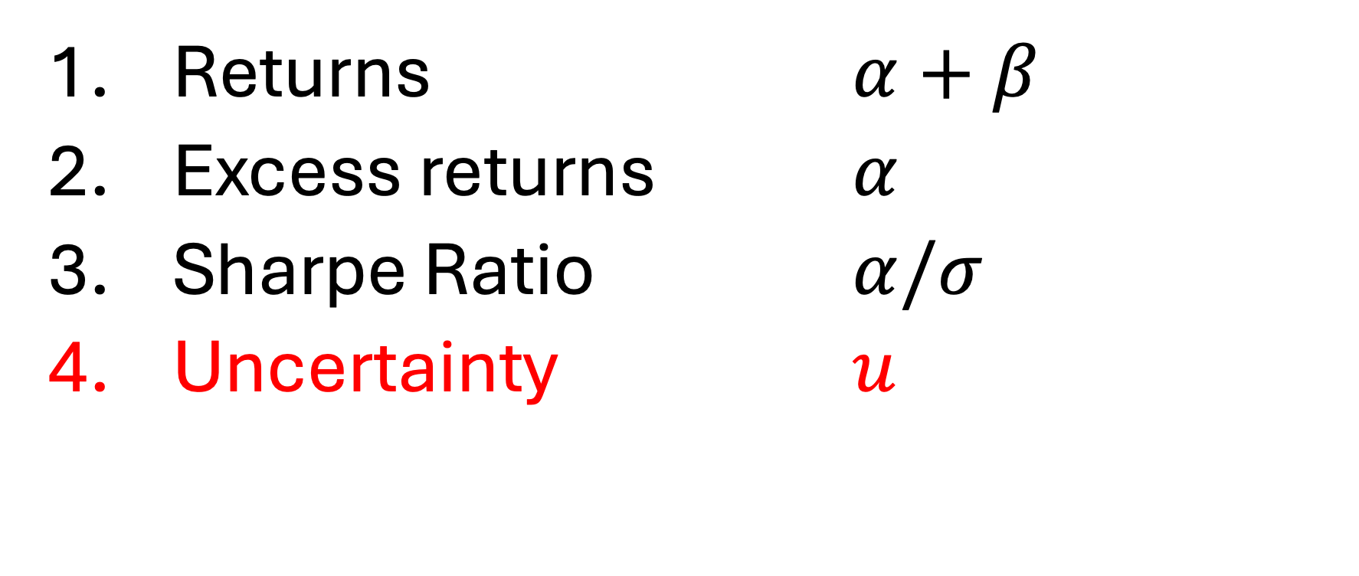
How to evaluate an investment?
Returns $α+β$
Excess returns $α$
Sharpe Ratio $α/σ$
Uncertainty $u$

Slide 3
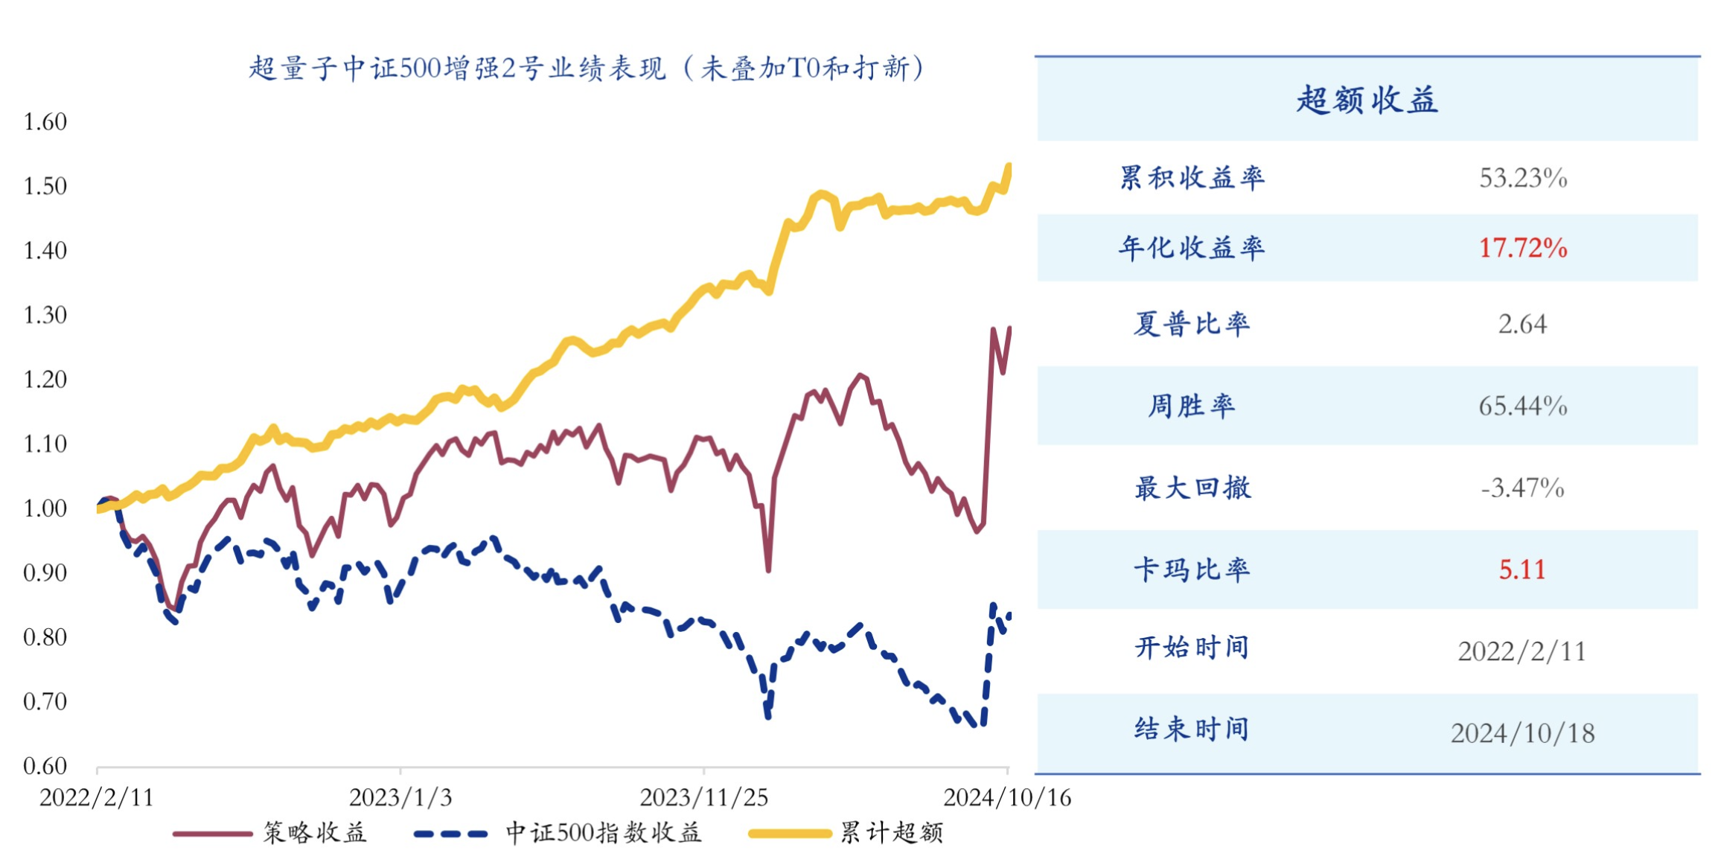

Slide 4
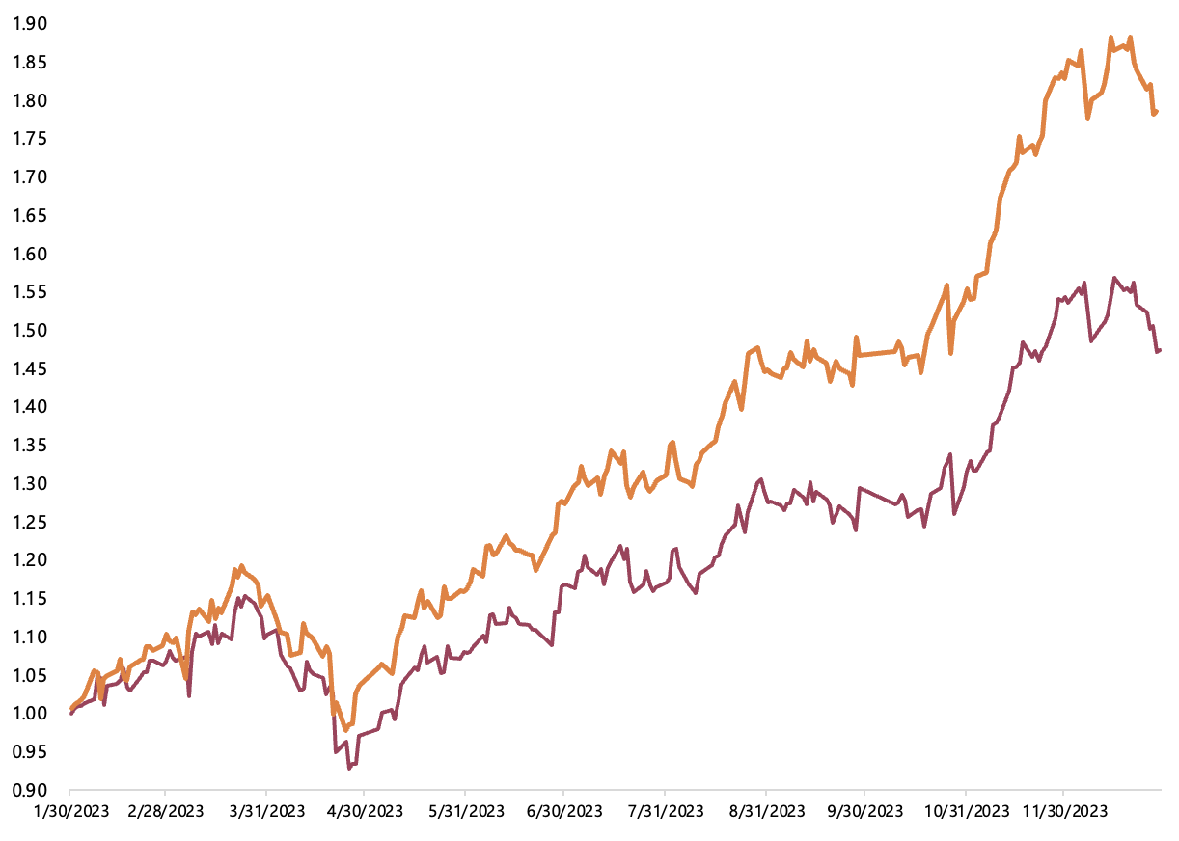

Slide 5
背景
创始人
AlphaSimplex
合伙人
团队
只做校招
流水线管理，没有PM
共享资源、知识
内部同行评审机制
培养人，零流失，3亿的时候30人
产品特点
只做股票策略
专注资管，不做自营，和投资人利益绑定
只做宽基指数
只做中低频
偏好大容量策略
投研系统

Slide 6
Background
Founded 2019, now AUM=5 billion RMB, 50 team members
Founders
AlphaSimplex
Partners
Team
Only school hiring
Streamline model，no PMs
Sharing of resources and knowledge
Peer review
Cultivation，zero turn over
Already 30 people when AUM=300 million
Products
Only stock strategies
Focus on asset management, no flagship products, incentive compatible with investors
Focus on large and liquid stocks
Focus on medium to low frequency trading
Prefer large-capacity strategies
Investment Research System

Slide 8
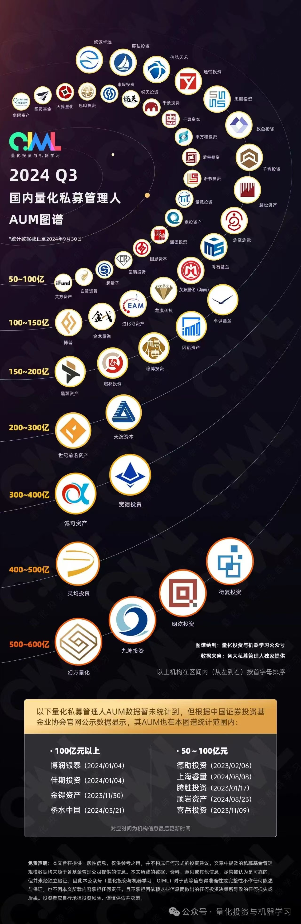

Slide 9
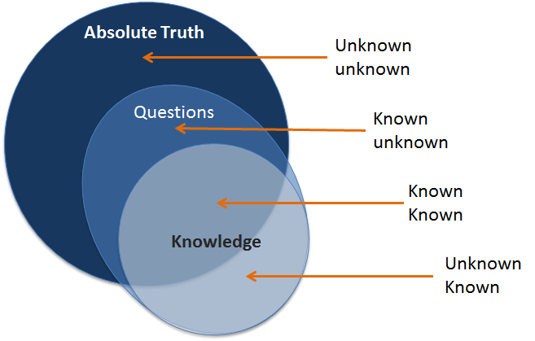
(3)
(2)
(1)
(4)

Slide 10
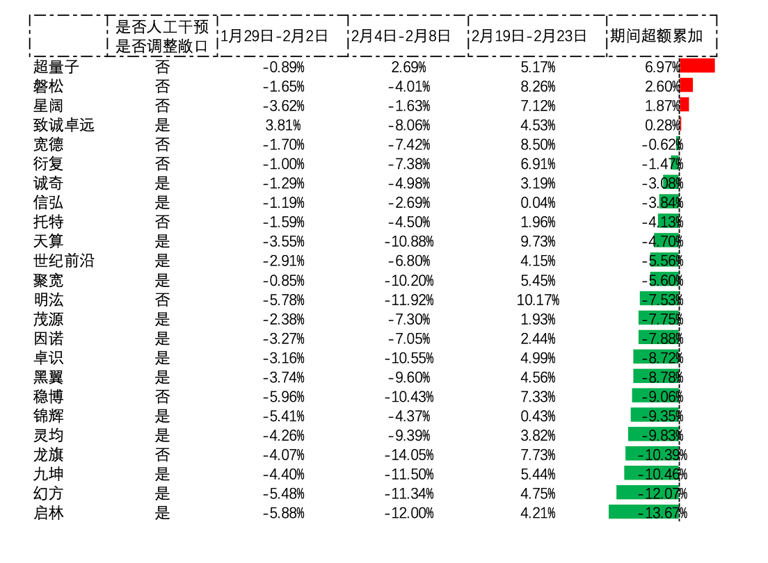

Slide 11
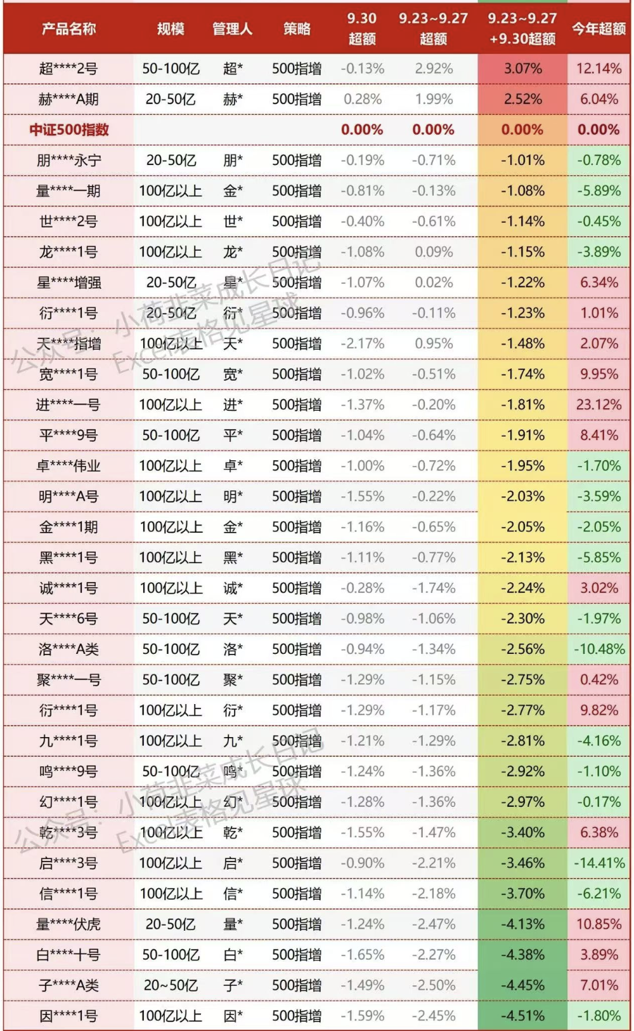
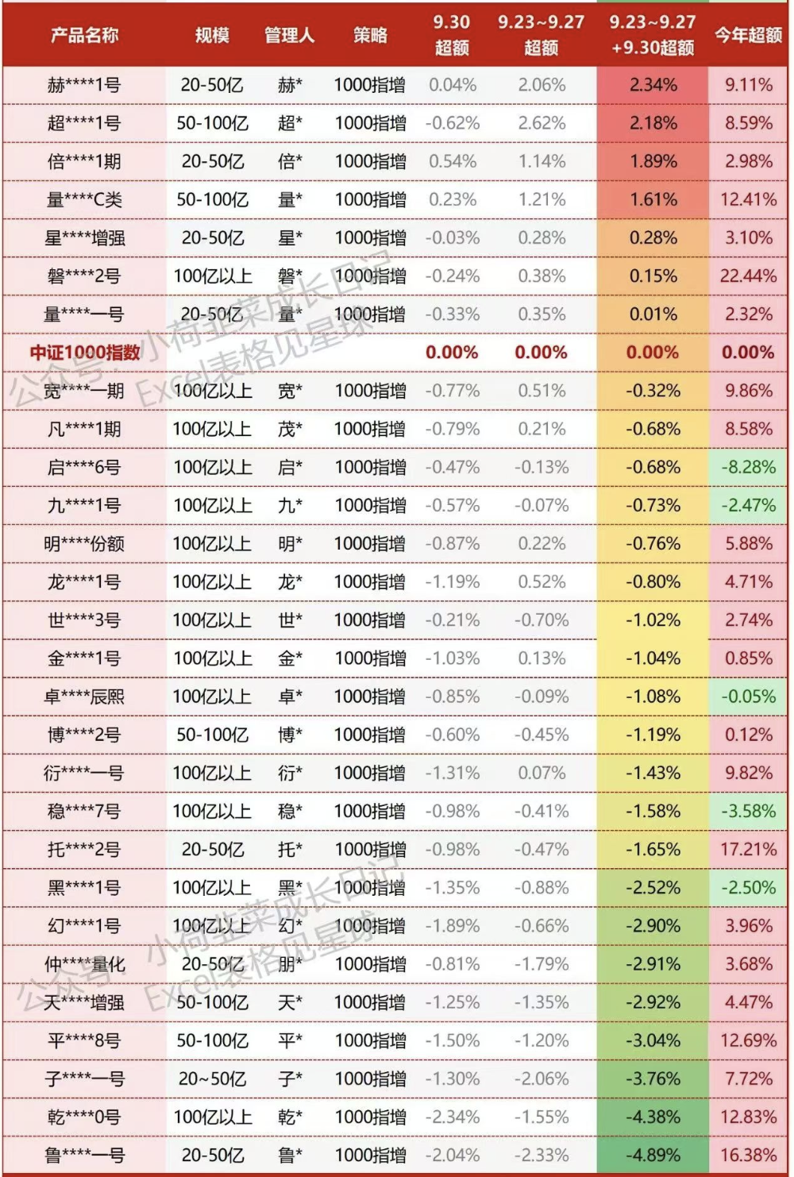
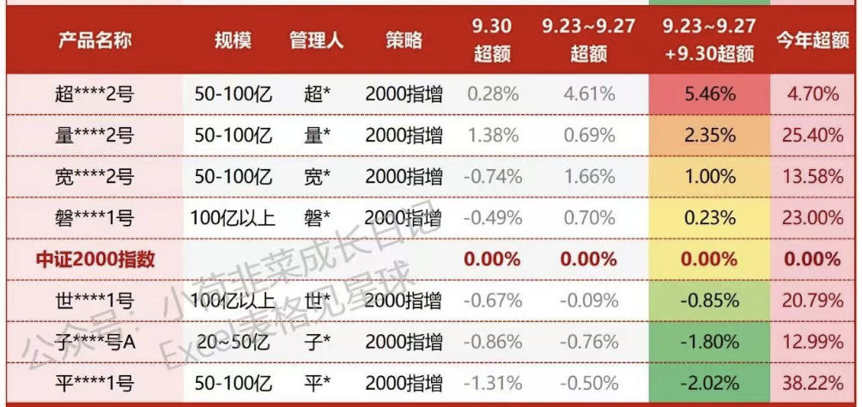

Slide 12
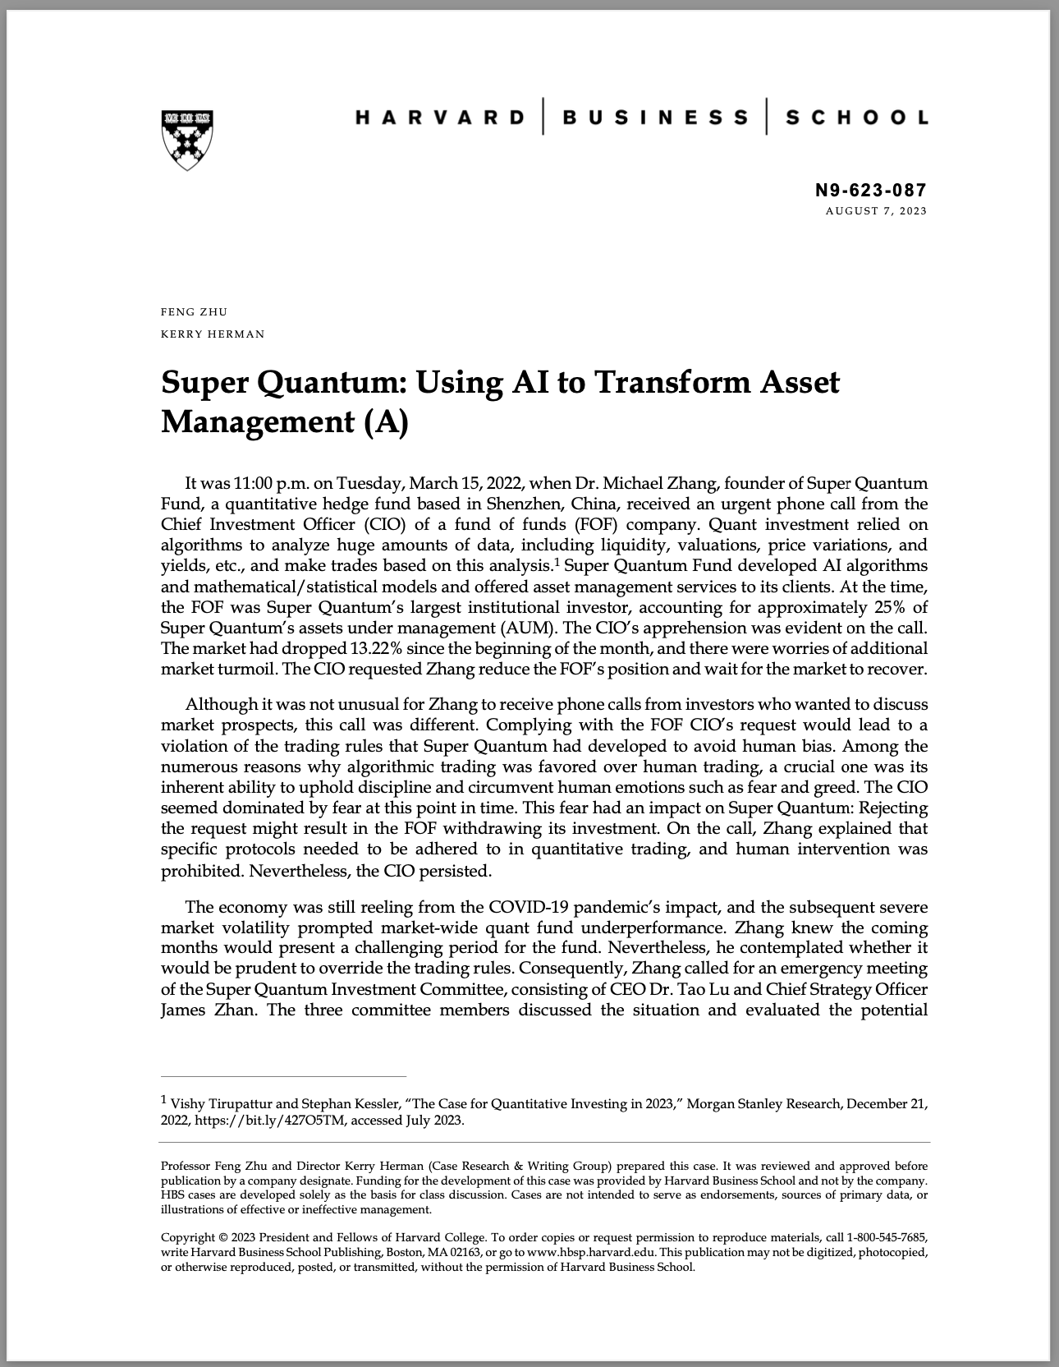
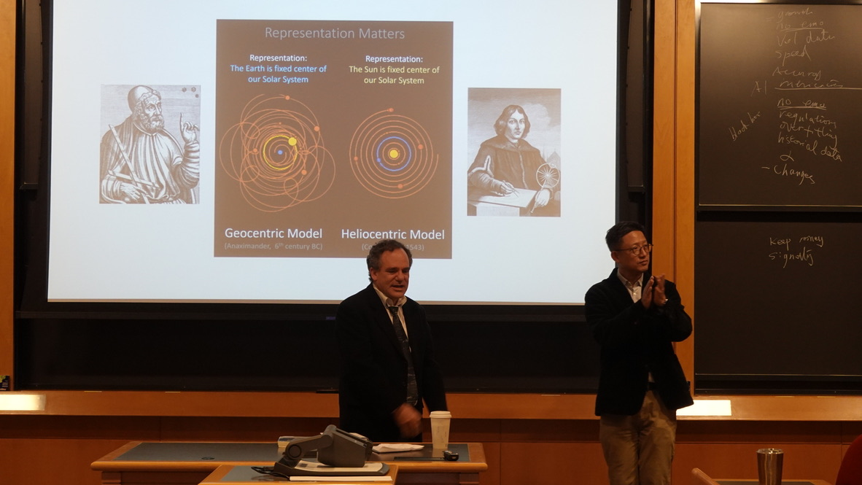
How to decode the financial market?
Practice

Slide 13
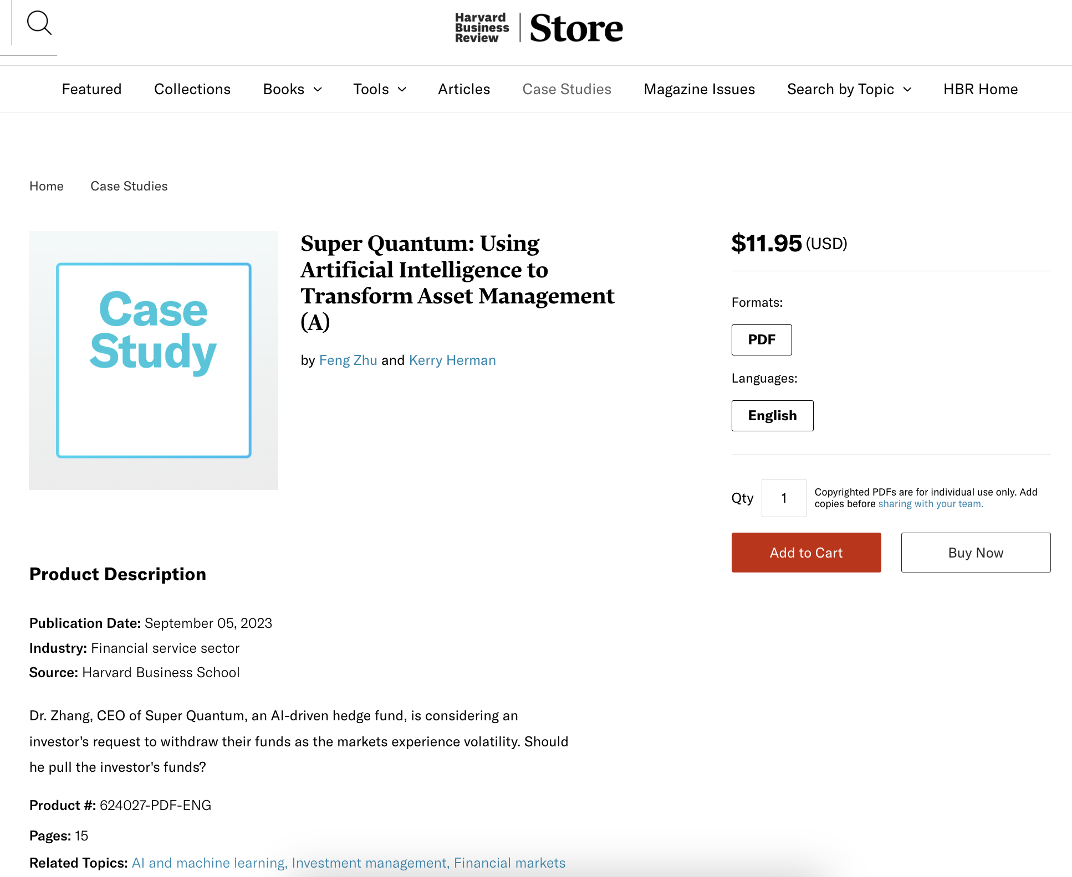

Slide 14
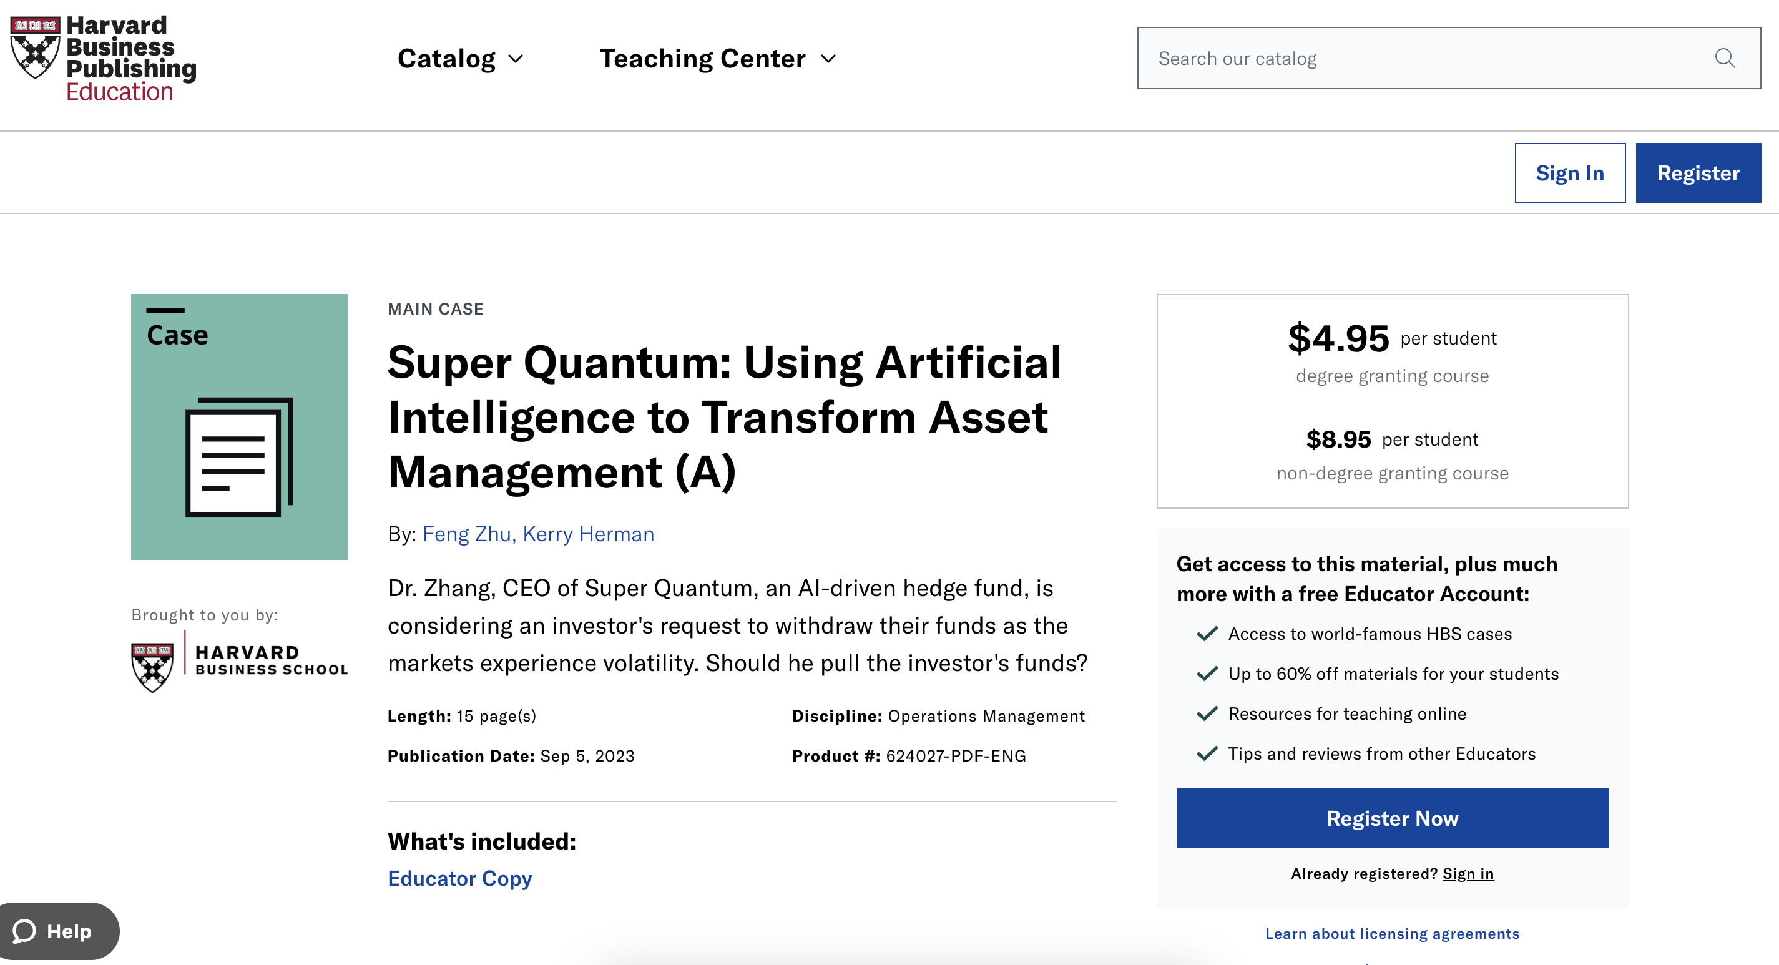

Slide 15
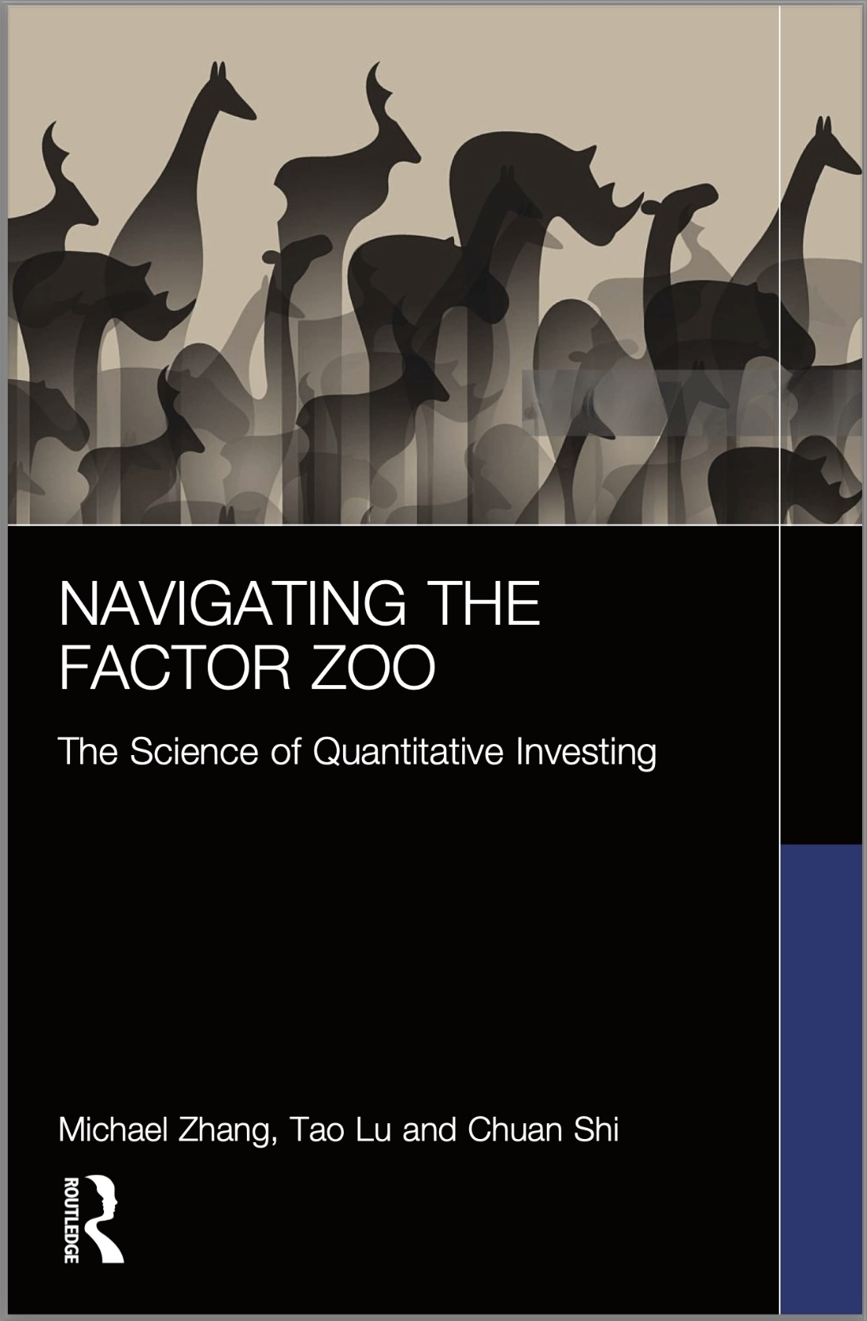

It is instantly clear that the authors combine deep academic knowledge with a wealth of practical market experience.
Yuriy Nevmyvaka, PhD
Managing Director, Head of Machine Learning Research, Morgan Stanley
Ivory Tower meets Wall Street – Packed with academic rigor and practical relevance, this is an important and compelling read.
Michael Saunders, PhD
Professor, Stanford University

Slide 16
How to decode the financial market? Research
Tao Lu, Lihong Zhang, Michael Zhang, Zhenling Zhao, "Beyond Risk: A Measure of Distribution Uncertainty"Information Systems Research, forthcoming.
Lihong Zhang and Michael Zhang, "Mispricing and Algorithm Trading," Information Systems Research, forthcoming.
Jialu Liu, Siqi Pei, and Michael Zhang, "Indirect Value of Public Infrastructure Technology," Management Science, forthcoming.
Tim Li and Michael Zhang, "Development Trajectory of Blockchain Platforms: the Role of Multi-Role," Information Systems Research, forthcoming.
Terry Hendershott, Michael Zhang, Leon Zhao, and Eric Zheng, "FinTech as a Game Changer: Overview of Research Frontiers," Information Systems Research, 32(1), 2021, 1-17.
Michael Zhang, and Lihong Zhang, "How Does the Internet Affect the Financial Market? An Equilibrium Model of Internet Facilitated Feedback Trading," MIS Quarterly, 39, 1, 2015, 17-38.
Sean Xin Xu and Michael Zhang "Impact of Wikipedia on Market Information Environment: Evidence on Management Disclosure and Investor Reaction," MIS Quarterly, 37, 4, 2013, 1043-1068.

Slide 17
Research: Working papers
Liu, Y., Zhang, L., and Zhang, X., "Statistical Inference under Ambiguity"
Ning Jia, Sean Xu, Zhitao Yin, and Michael Zhang, "Investor Misreaction to Secondhand Information on Social Media: Evidence from a Wikipedia Experiment”
Cheng, B., Zhang, L. and Zhang, X. "Uncertainty and Failure of Diversification"
Zhang, X., Xu, D., Hong, H. "Investor Attention or Investor Sentiment: How Social Media React to ESG?"
Gao, C., Hong, H., Zhang, X., and Ye, Q., "Seeking Alpha or Seeking Noise? Attention Bias in Online Investment Communities”
Liu, A., Xu, X., Zhang, X., and Zhao, X., "Social Media and Financial Information Asymmetry: How Information Aggregation on Wikipedia Reduces Insider Trading Profitability.”
Lihong Zhang, Gene Lai, Baimin Yu and Michael Zhang, "Longevity Risk, Optimal Retirement, Consumption Choice, and Risky Investment Decision"
Wu, W., Zhang, X., and Zheng, R., "An Empirical Study on the Monitoring Role of Wikipedia in the Financial Market."
Wu, W., Shi, W., Zhang, X., and Zheng, R., "Firm Performance and Information Dissemination: Evidence from Twitter."
Zhang, T., and Zhang, X., "Corporate Campaign Contributions and Political Favoritism."

Slide 18
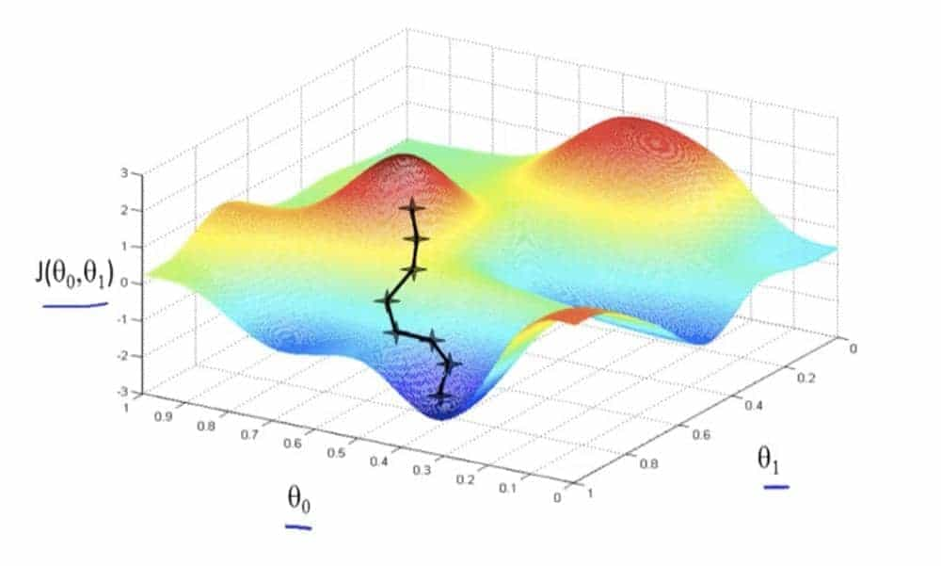
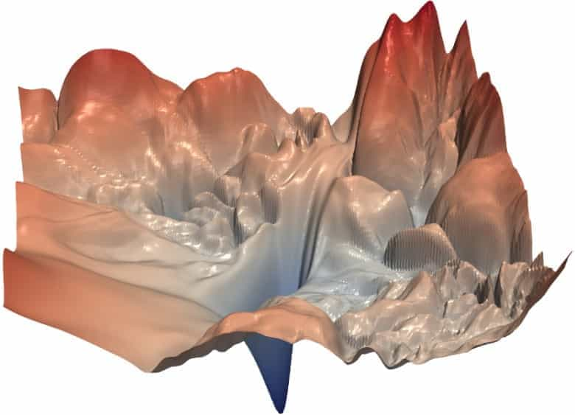

Limitations of Machine Learning
Gradient Descent

Slide 19
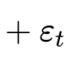
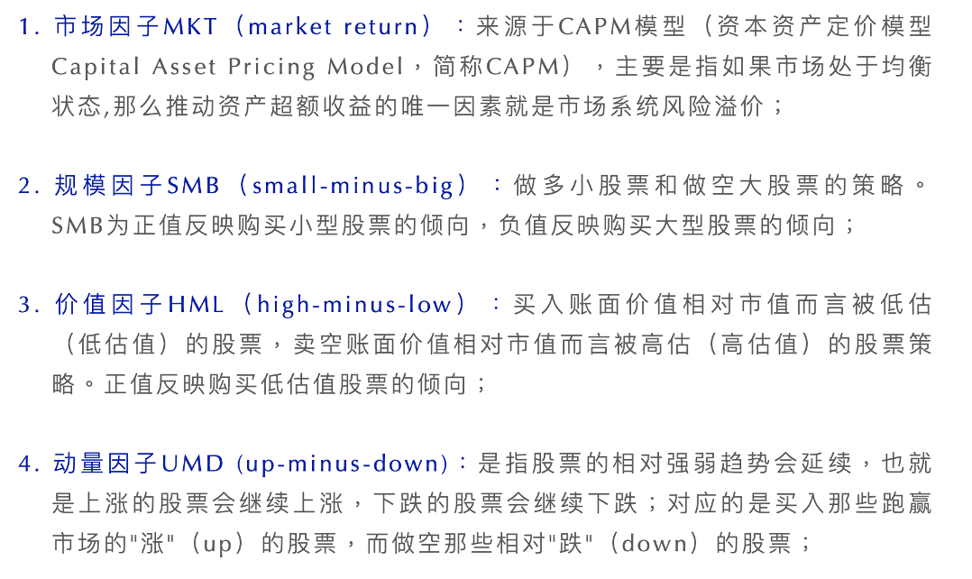
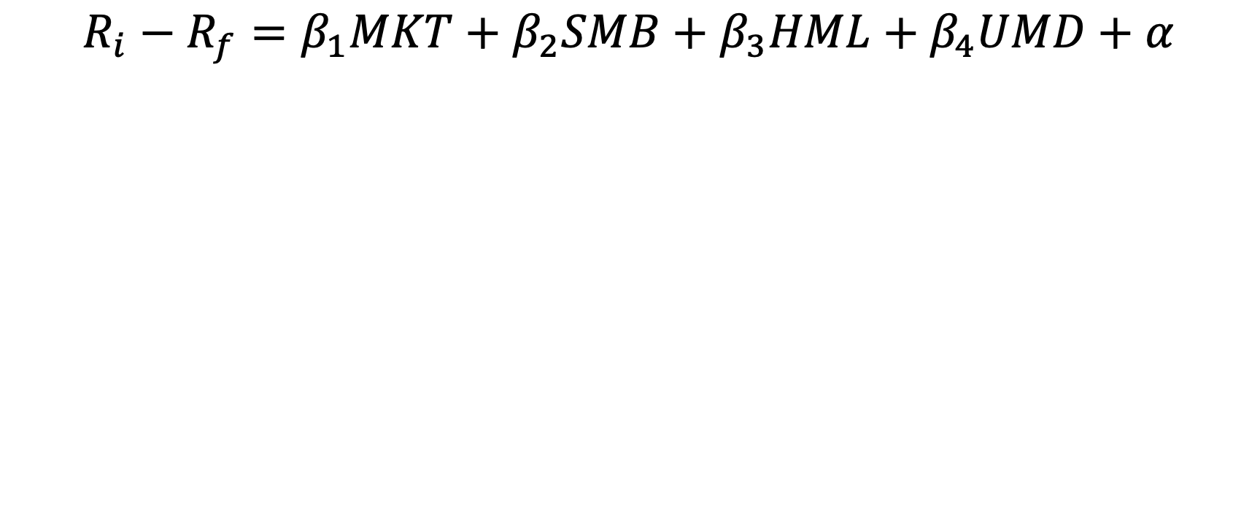
$$R_{i}−R_{f}=β_{1}MKT+β_{2}SMB+β_{3}HML+β_{4}UMD+α$$

Slide 20
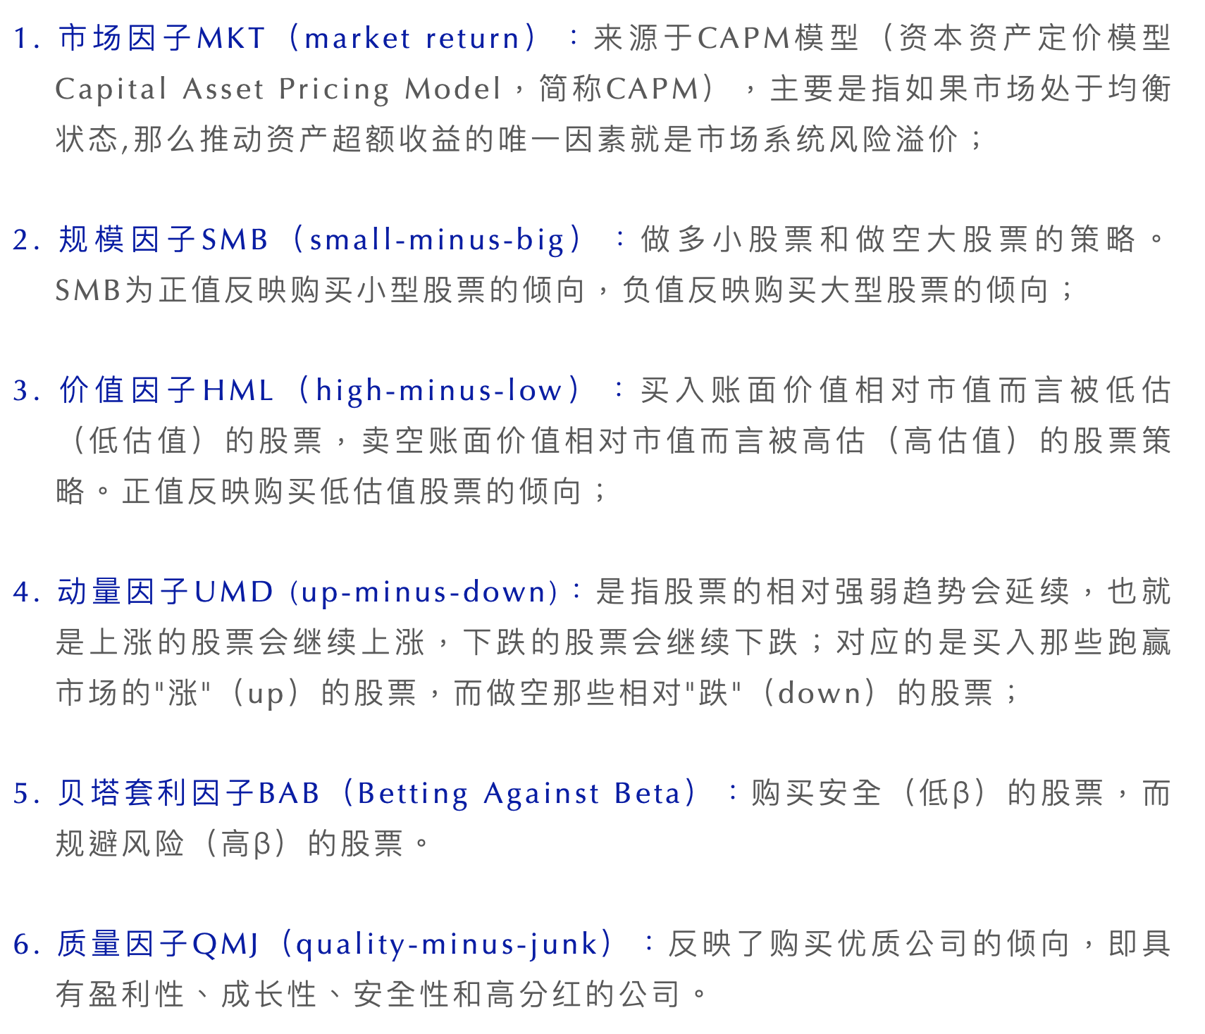
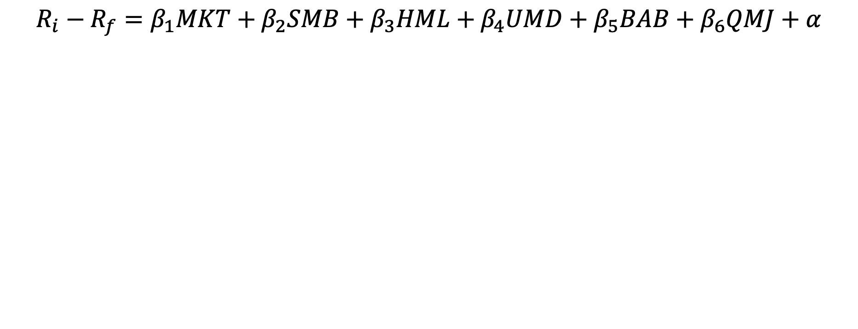
$$R_{i}−R_{f}=β_{1}MKT+β_{2}SMB+β_{3}HML+β_{4}UMD+β_{5}BAB+β_{6}QMJ+α$$

Slide 21
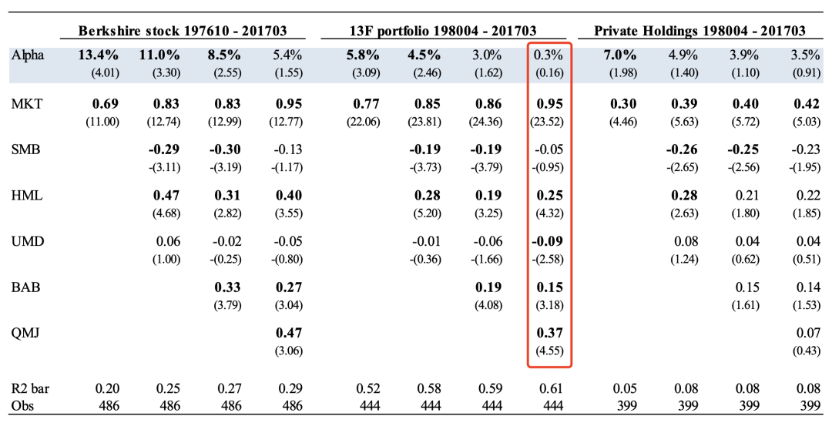
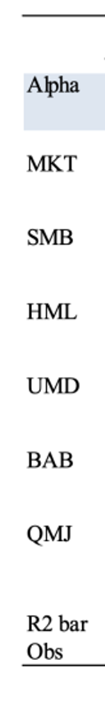
市场因子
规模因子
价值因子
动量因子
低β因子
质量因子

Slide 22
Uncertainty
Risk
Volatility

Slide 23
分布未知
分布已知
分布的参数

Slide 25
1987 crash (20 sigma away from mean)
# atoms: 10⁷⁸~10⁸²
Age of universe in seconds: 10^{17.} (13.7 billion years)
Prob ~ 10⁻⁸⁹
Notes:
1987 crash is more than 20 sigma away from mean

Slide 26
Observation
Pattern
Induction （Engineering）
Hypothesis
Theory
VS
Confirmation
Observation
Deduction
（Science）
Hypothesis
Theory

Slide 27
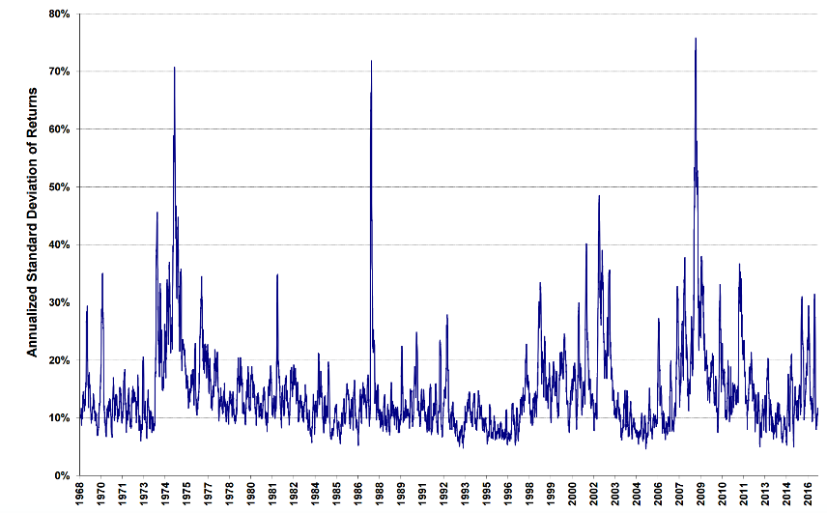
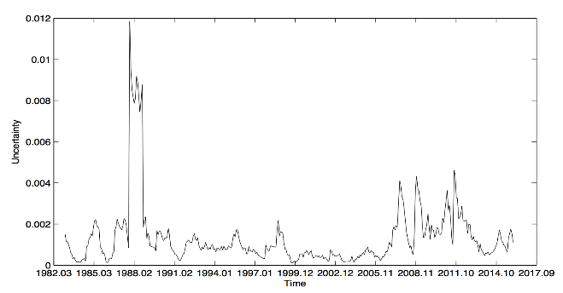
与标普500指数收益相关的不确定性衡量
年化收益率标准差
Volatility
Uncertainty
不确定性

Slide 28
Simulation

Slide 29
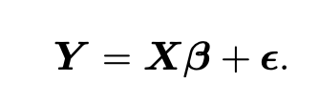
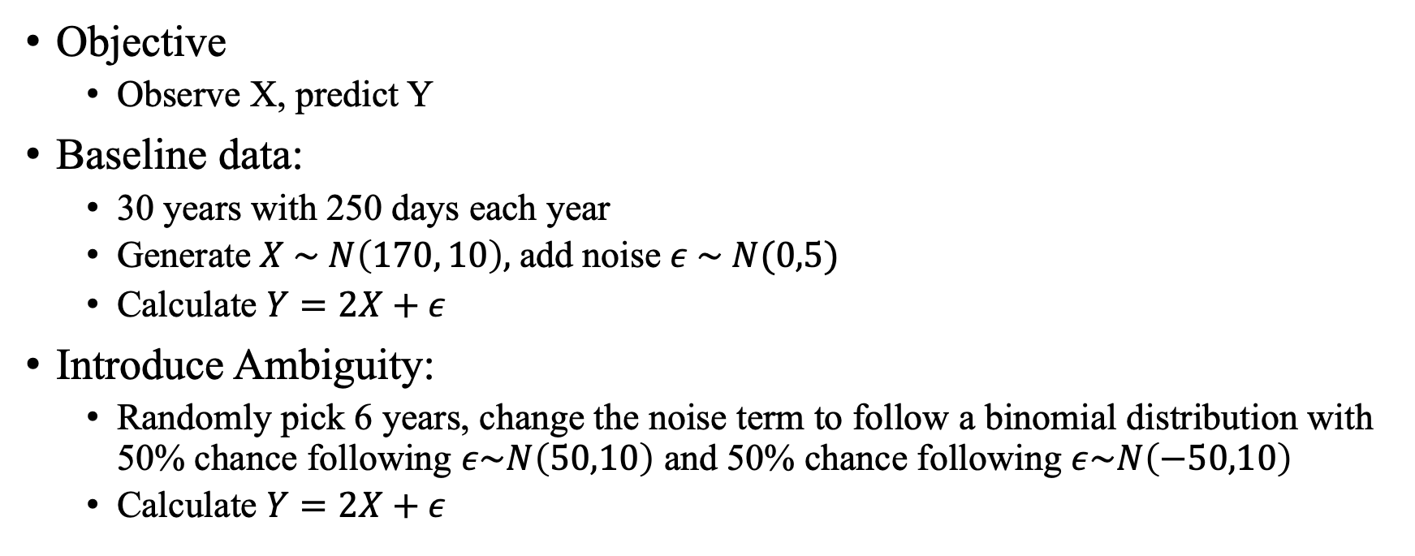
Simulation
Objective
Observe X, predict Y
Baseline data:
30 years with 250 days each year
Generate $X \sim N\left(170, 10\right),$add noise $ε \sim N(0,5)$
Calculate $Y=2X+ε$
Introduce Ambiguity:
Randomly pick 6 years, change the noise term to follow a binomial distribution with 50% chance following $ε\sim N\left(50,10\right)$ and 50% chance following $ε\sim N\left(−50,10\right)$
Calculate $Y=2X+ε$

Slide 30
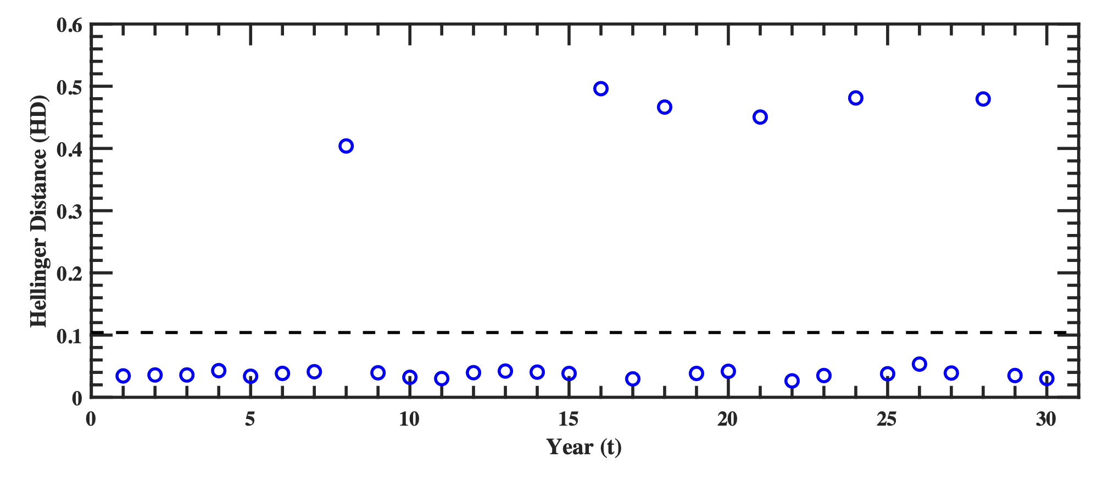
Ambiguity Measured

Slide 31
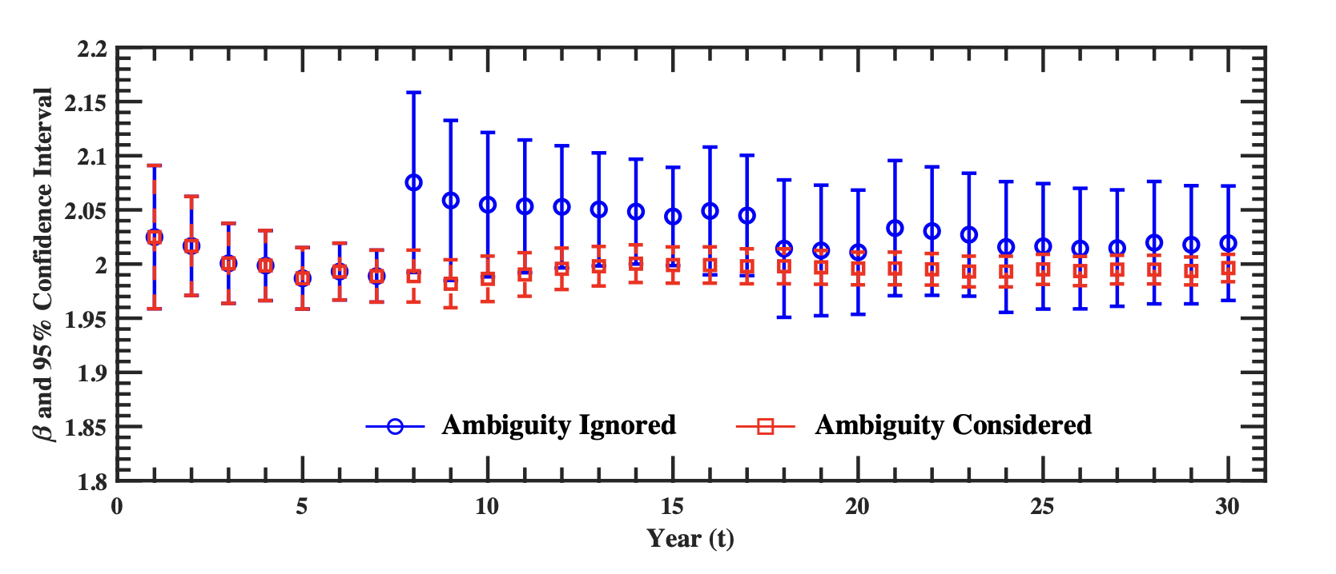

Slide 32
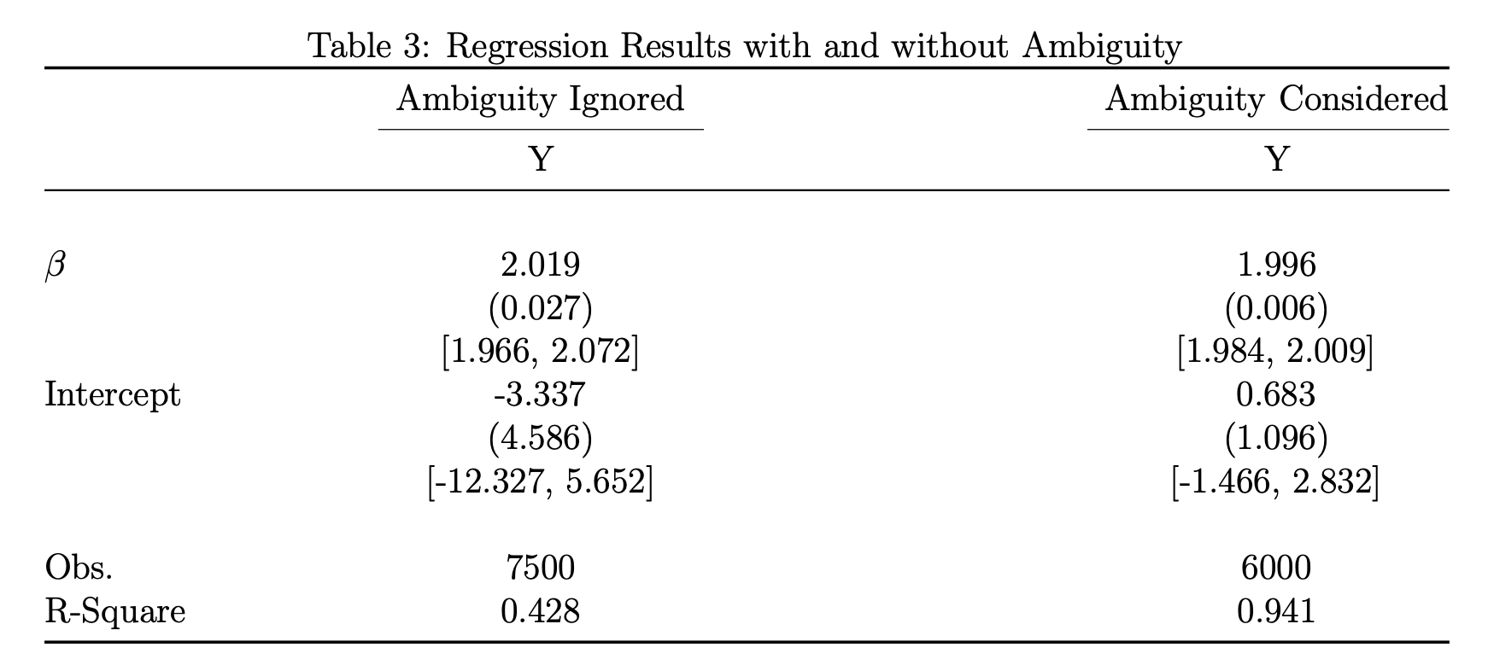

Slide 33
Application

Slide 35
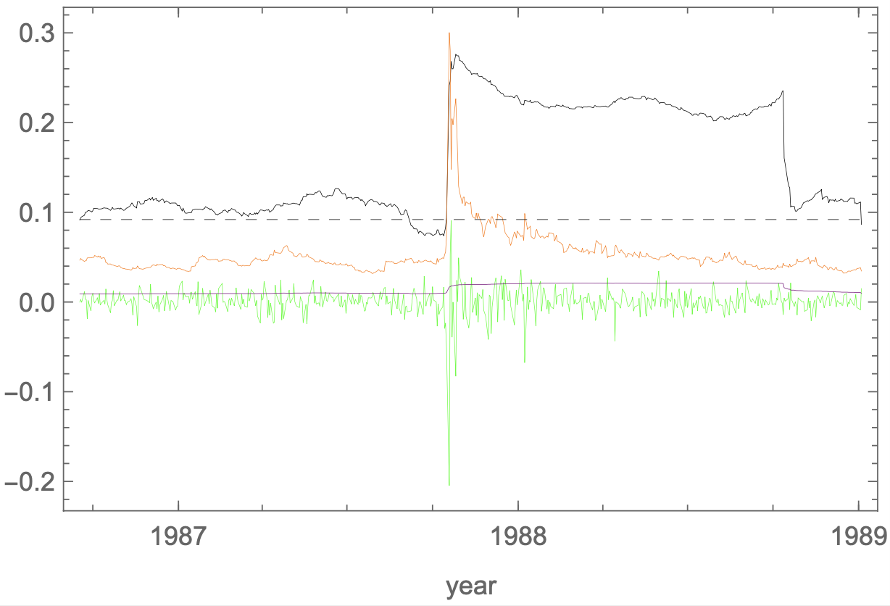

Slide 36
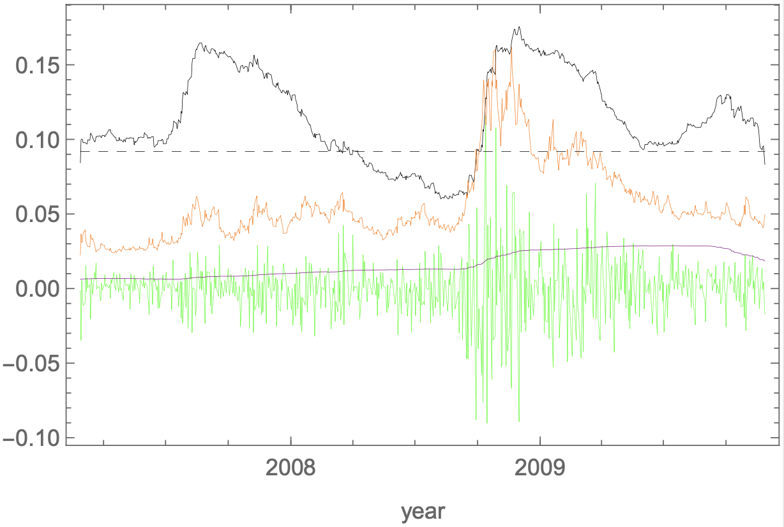

Slide 37
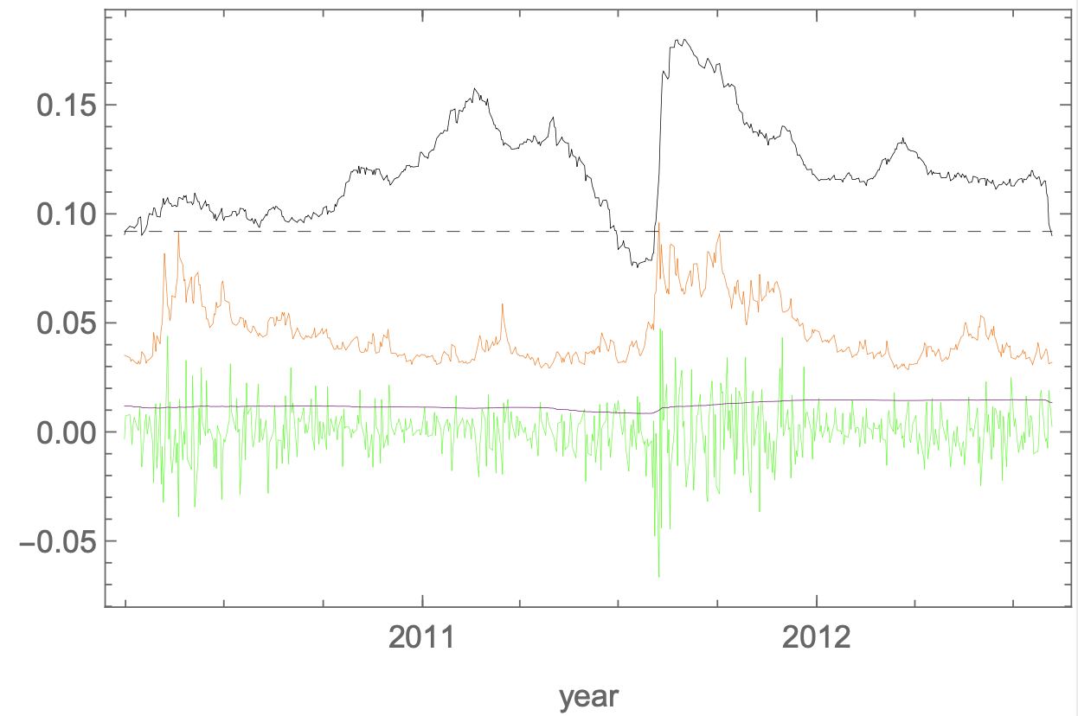

Slide 38
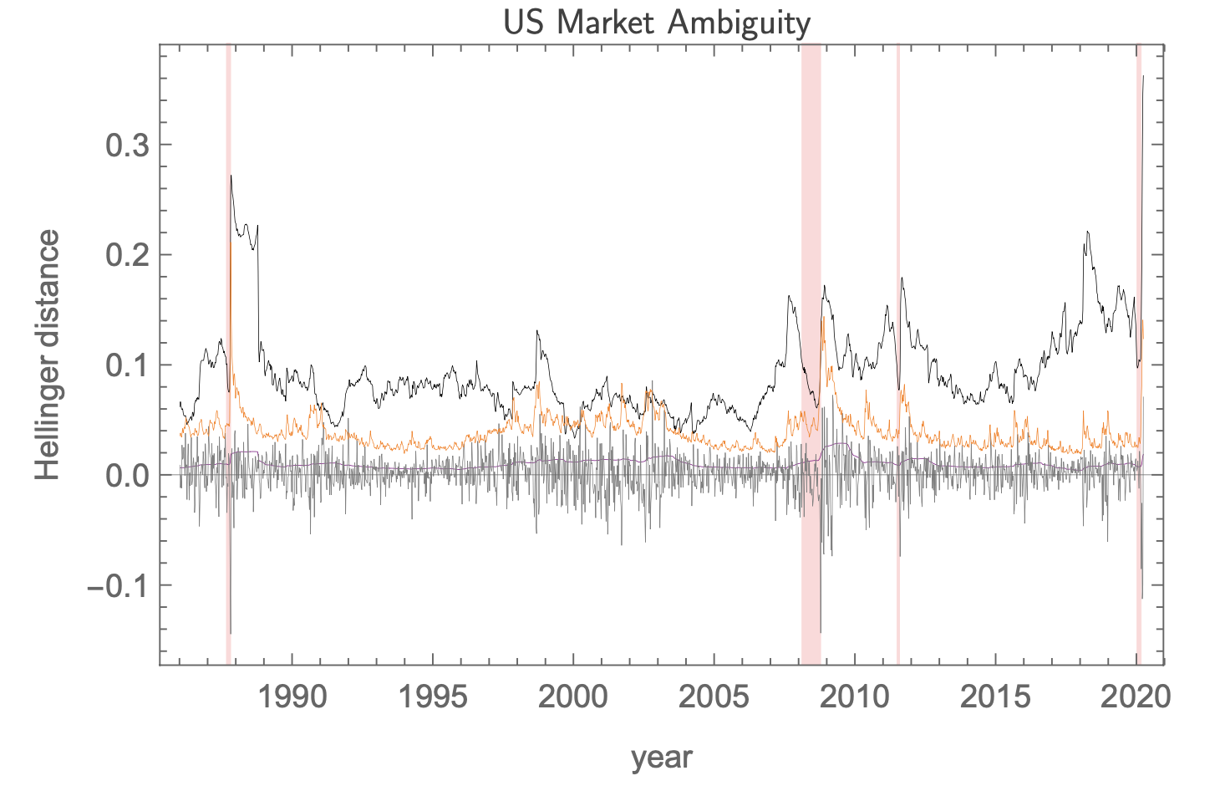

Slide 39
Logic

Slide 40
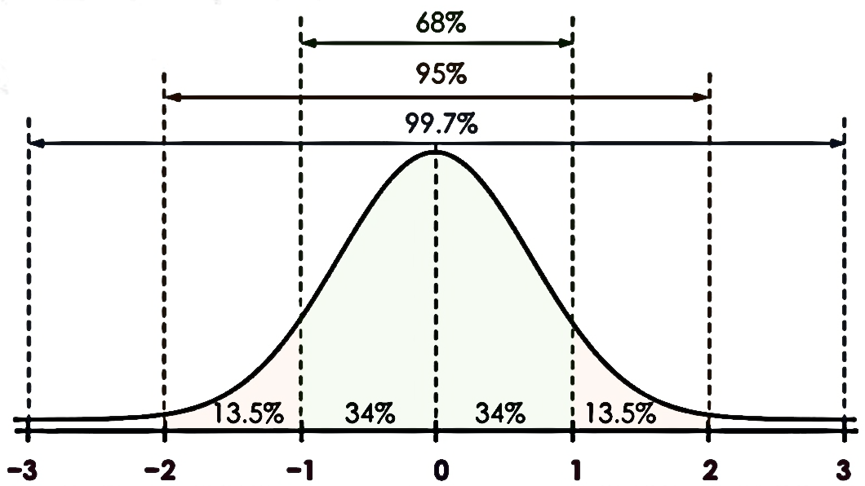
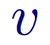
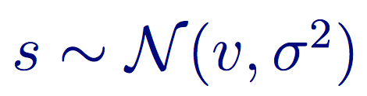
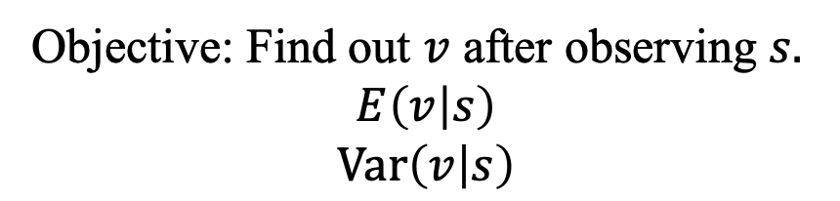
Classical Statistical Inference
Objective: Find out $v$ after observing $s.$ $$E\left(v | s\right)$$
$$Var\left(v | s\right)$$

Slide 41
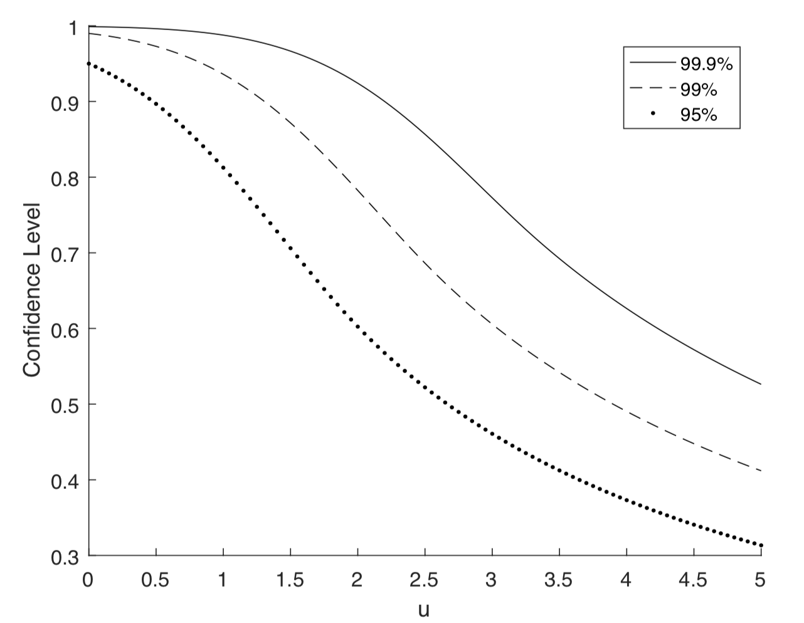
Changes in Confidence Intervals

Slide 42
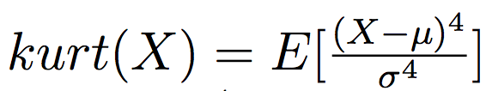
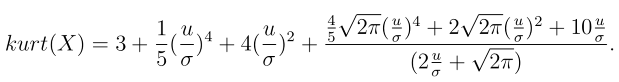
Kurtosis – Black Swan Events and Fat Tails
Krutosis is defined as
Accordingly, with ambiguity, the kurtosis is:
Normal distribution has kurtosis 3, so we can quantify the “fat tail”, when there is ambiguity.

Slide 43
Demise of Long-Term Capital Management

Slide 44
Philosophy

Slide 45
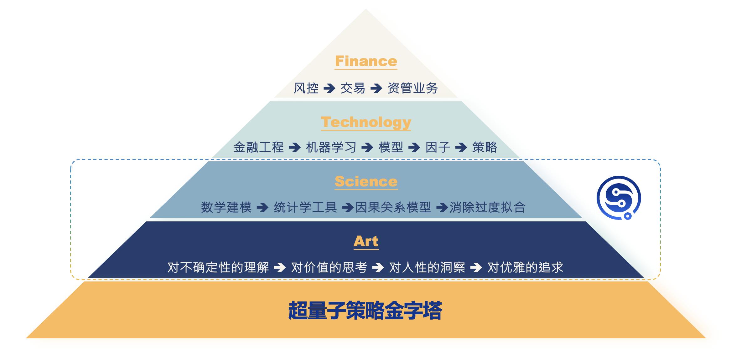

Slide 46
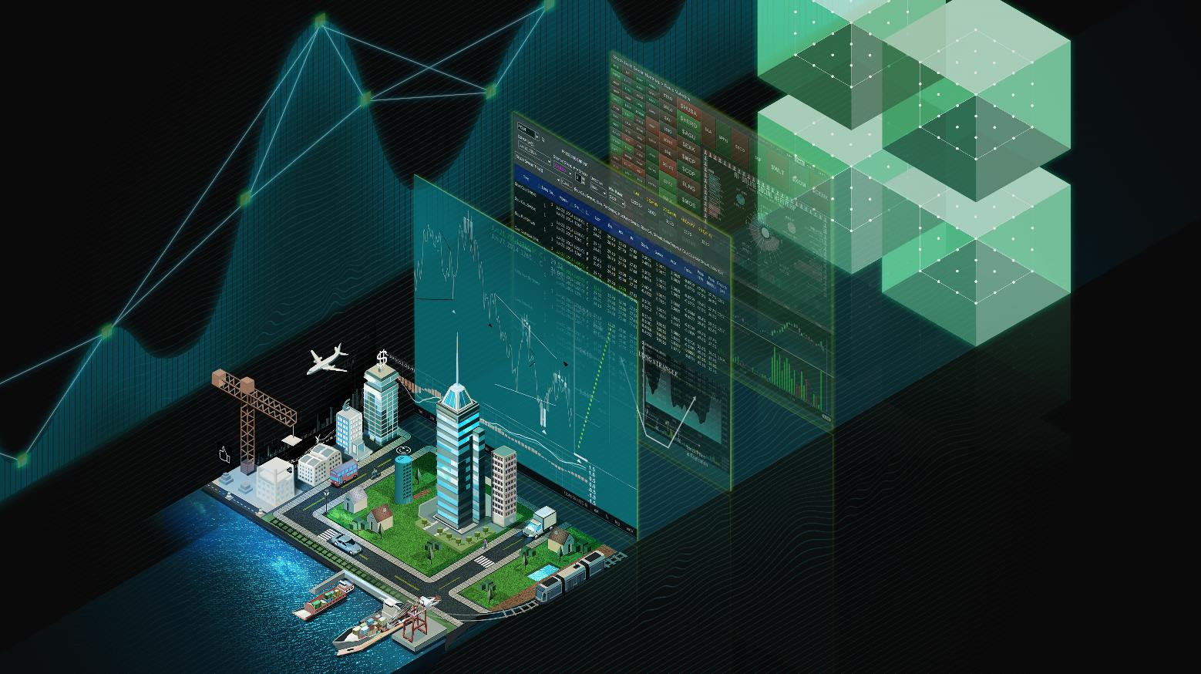

Q&A

